Slide 1
Chapter 5 Digital Building Blocks(1) -Arithmetic Circuits
Suffolk County Community College
CSE 222, Spring 2020

Slide 2
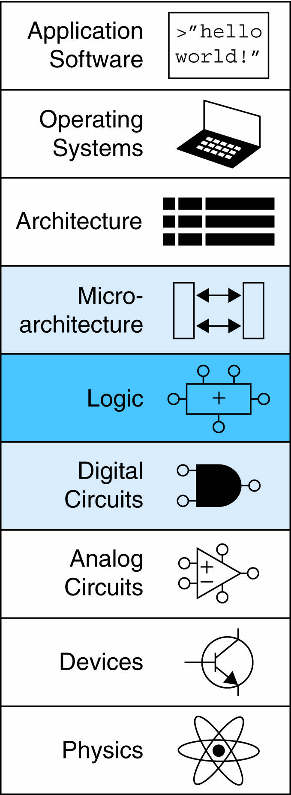
Topics:
Introduction
Arithmetic Circuits
Number Systems
Sequential Building Blocks
Memory Arrays
Logic Arrays

Slide 3
Introduction
Digital building blocks:
Gates, multiplexers, decoders, registers, arithmetic circuits, counters, memory arrays, logic arrays
Building blocks demonstrate hierarchy, modularity, and regularity:
Hierarchy of simpler components
Well-defined interfaces and functions
Regular structure easily extends to different sizes
Will use these building blocks to build microprocessor

Slide 4
1-bit Adder

Slide 5
1-bit Adder

Slide 6
1-bit Adder

Slide 7
Multi-bits Adder (CPAs)
Types of carry propagate adders (CPAs):
Ripple-carry (slow)
Carry-lookahead (fast)
Prefix (faster)
Carry-lookahead and prefix adders faster for large adders but require more hardware
Symbol

Slide 8
Multi-bits Adder (CPAs)
Ripple-Carry Adder :
Chain 1-bit adders together
Carry ripples through entire chain
Disadvantage: slow
Ripple-Carry Adder Delay: t_{ripple} = Nt_{FA}
where t_{FA} is the delay of a full adder

Slide 9
Multi-bits Adder (CPAs)
Carry-Lookahead Adder
Compute carry out (C_{out}) for k-bit blocks using generate and propagate signals
Definitions:
Column i produces a carry out by either generating a carry out or propagating a carry in to the carry out
Generate (G_{i}) and propagate (P_{i}) signals for each column:
Column i will generate a carry out if A_{i} AND B_{i} are both 1.
G_{i} = A_{i} B_{i}
Column i will propagate a carry in to the carry out if A_{i} OR B_{i} is 1.
P_{i} = A_{i} + B_{i}
The carry out of column i (C_{i}) is:
C_{i} = A_{i} B_{i} + (A_{i} + B_{i} )C_{i-1} = G_{i} + P_{i} C_{i-1}

Slide 10
Multi-bits Adder (CPAs)
Carry-Lookahead Adder
Procedure
Step 1: Compute G_{i} and P_{i} for all columns
Step 2: Compute G and P for k-bit blocks
Step 3: C_{in} propagates through each k-bit propagate/generate block

Slide 11
Multi-bits Adder (CPAs)
Carry-Lookahead Adder
Example: 4-bit blocks (G_{3:0} and P_{3:0}) :
G_{3:0} = G₃ + P₃ (G₂ + P₂ (G₁ + P₁G₀ ))
P_{3:0} = P₃P₂ P₁P₀
Generally,
G_{i:j} = G_{i} + P_{i} (G_{i-1} + P_{i-1} (G_{i-2} + P_{i-2}G_{j} ))
P_{i:j} = P_{i}P_{i-1} P_{i-2}P_{j}
C_{i} = G_{i:j} + P_{i:j} C_{i-1}

Slide 12
Multi-bits Adder (CPAs)
Carry-Lookahead Adder
32-bit CLA with
4-bit blocks

Slide 13
Multi-bits Adder (CPAs)
Carry-Lookahead Adder
CLA Delay
For N-bit CLA with k-bit blocks:
t_{CLA} = t_{pg} + t_{pg_block} + (N/k – 1)t_{AND_OR} + kt_{FA}
t_{pg} : delay to generate all P_{i}, G_{i}
t_{pg_block} : delay to generate all P_{i:j}, G_{i:j}
t_{AND_OR}: delay from C_{in} to C_{out} of final AND/OR gate in k-bit CLA block
An N-bit carry-lookahead adder is generally much faster than a ripple-carry adder for N > 16

Slide 14
Multi-bits Adder (CPAs)
Prefix Adder
Computes carry in (C_{i-1}) for each column, then computes sum:
S_{i} = (A_{i} ⊕ B_{i}) ⊕ C_{i-1}
Computes G and P for 1-, 2-, 4-, 8-bit blocks, etc. until all G_{i} (carry in) known
log₂N stages

Slide 15
Multi-bits Adder (CPAs)
Prefix Adder
Carry in either generated in a column or propagated from a previous column.
Column -1 holds C_{in}, so
G₋₁ = C_{in}, P₋₁ = 0
Carry in to column i = carry out of column i-1:
C_{i-1} = G_{i-1:-1}
G_{i-1:-1}: generate signal spanning columns i-1 to -1
Sum equation:
S_{i} = (A_{i} ⊕ B_{i}) ⊕ G_{i-1:-1}
Goal: Quickly compute G_{0:-1}, G_{1:-1}, G_{2:-1}, G_{3:-1}, G_{4:-1}, G_{5:-1}, … (called prefixes)

Slide 16
Multi-bits Adder (CPAs)
Prefix Adder
Generate and propagate signals for a block spanning bits i:j:
G_{i:j} = G_{i:k} + P_{i:k} G_{k-1:j}
P_{i:j} = P_{i:k}P_{k-1:j}
In words:
Generate: block i:j will generate a carry if:
upper part (i:k) generates a carry or
upper part propagates a carry generated in lower part (k-1:j)
Propagate: block i:j will propagate a carry if:
both the upper and lower parts propagate the carry

Slide 17
Multi-bits Adder (CPAs)
Prefix Adder
Schematic

Slide 18
Multi-bits Adder (CPAs)
Prefix Adder
Delay
t_{PA} = t_{pg} + log₂N(t_{pg_prefix} ) + t_{XOR}
t_{pg}: delay to produce P_{i} G_{i} (AND or OR gate)
t_{pg_prefix}: delay of black prefix cell (AND-OR gate)
t_{XOR}: delay to produce S_{i} (XOR gate)

Slide 19
Adder Delay Comparisons
Compare delay of: 32-bit ripple-carry, carry-lookahead, and prefix adders
CLA has 4-bit blocks
2-input gate delay = 100 ps; full adder delay = 300 ps
t_{ripple} = Nt_{FA} = 32(300 ps)
= 9.6 ns
t_{CLA} = t_{pg} + t_{pg_block} + (N/k – 1)t_{AND_OR} + kt_{FA}
= [100 + 600 + (7)200 + 4(300)] ps
= 3.3 ns
t_{PA} = t_{pg} + log₂N(t_{pg_prefix} ) + t_{XOR}
= [100 + log₂32(200) + 100] ps
= 1.2 ns

Slide 20
Subtractor
Notes:
2’s complement – reverse each bits + 1: C_{in} is 1

Slide 21
Comparator: Equality

Slide 22
Comparator: Less than
Notes:
negative number - sign bit is 1

Slide 23
ALU: Arithmetic Logic Unit
F_{2:0} | Function
000 | A & B
001 | A | B
010 | A + B
011 | not used
100 | A & ~B
101 | A | ~B
110 | A - B
111 | SLT

Slide 24
ALU: Arithmetic Logic Unit
F_{2:0} | Function
000 | A & B
001 | A | B
010 | A + B
011 | not used
100 | A & ~B
101 | A | ~B
110 | A - B
111 | SLT

